Slide 1

Power Point Presentation On
Newspaper Blogging System
Presented By -
Shuvradip Chakraborty

Slide 2
About the Project
The project aims to develop content in the Online News Publishing Category. Newspaper Blog is a PHP Custom theme that lets you write articles and blog posts with ease. Create a great news with our newspaper Website This Application is perfect for blogging and excellent for an Mobile As Well As Desktop Reader For Its In built Mobile Support,
Here We Describe About The Features Of Newspaper Blog
Fast ,Responsive And Mobile Friendly (IPad and iPhone friendly)
Clean and Unique Design
5000+ Font Icon Included
Very Smooth Transition Effects
W3C 100% Valid Code
Extensive Documentation
Working Contact form
Cross-browser compatible with Edge, IE11+, Firefox, Safari, Opera, Chrome

Slide 3
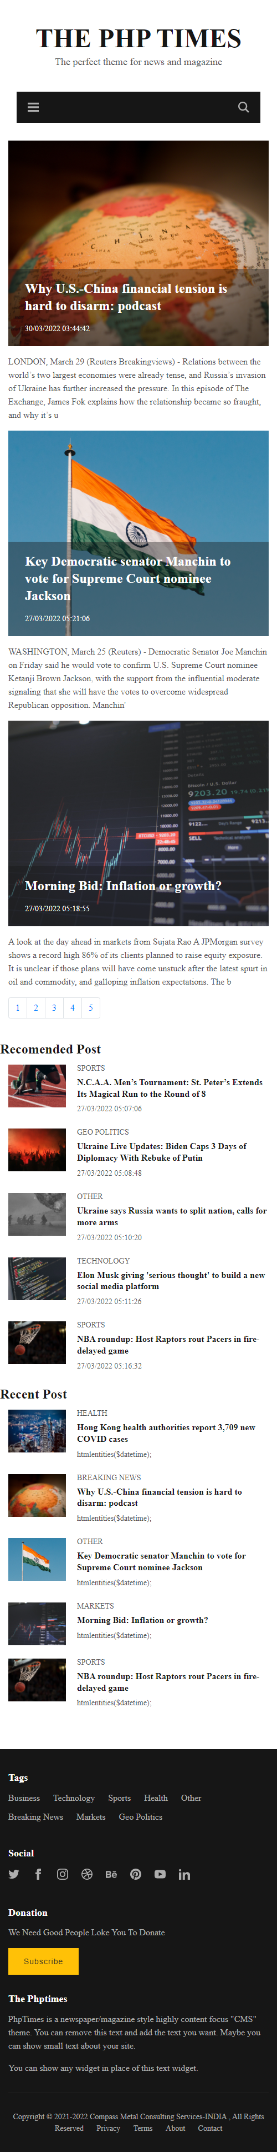
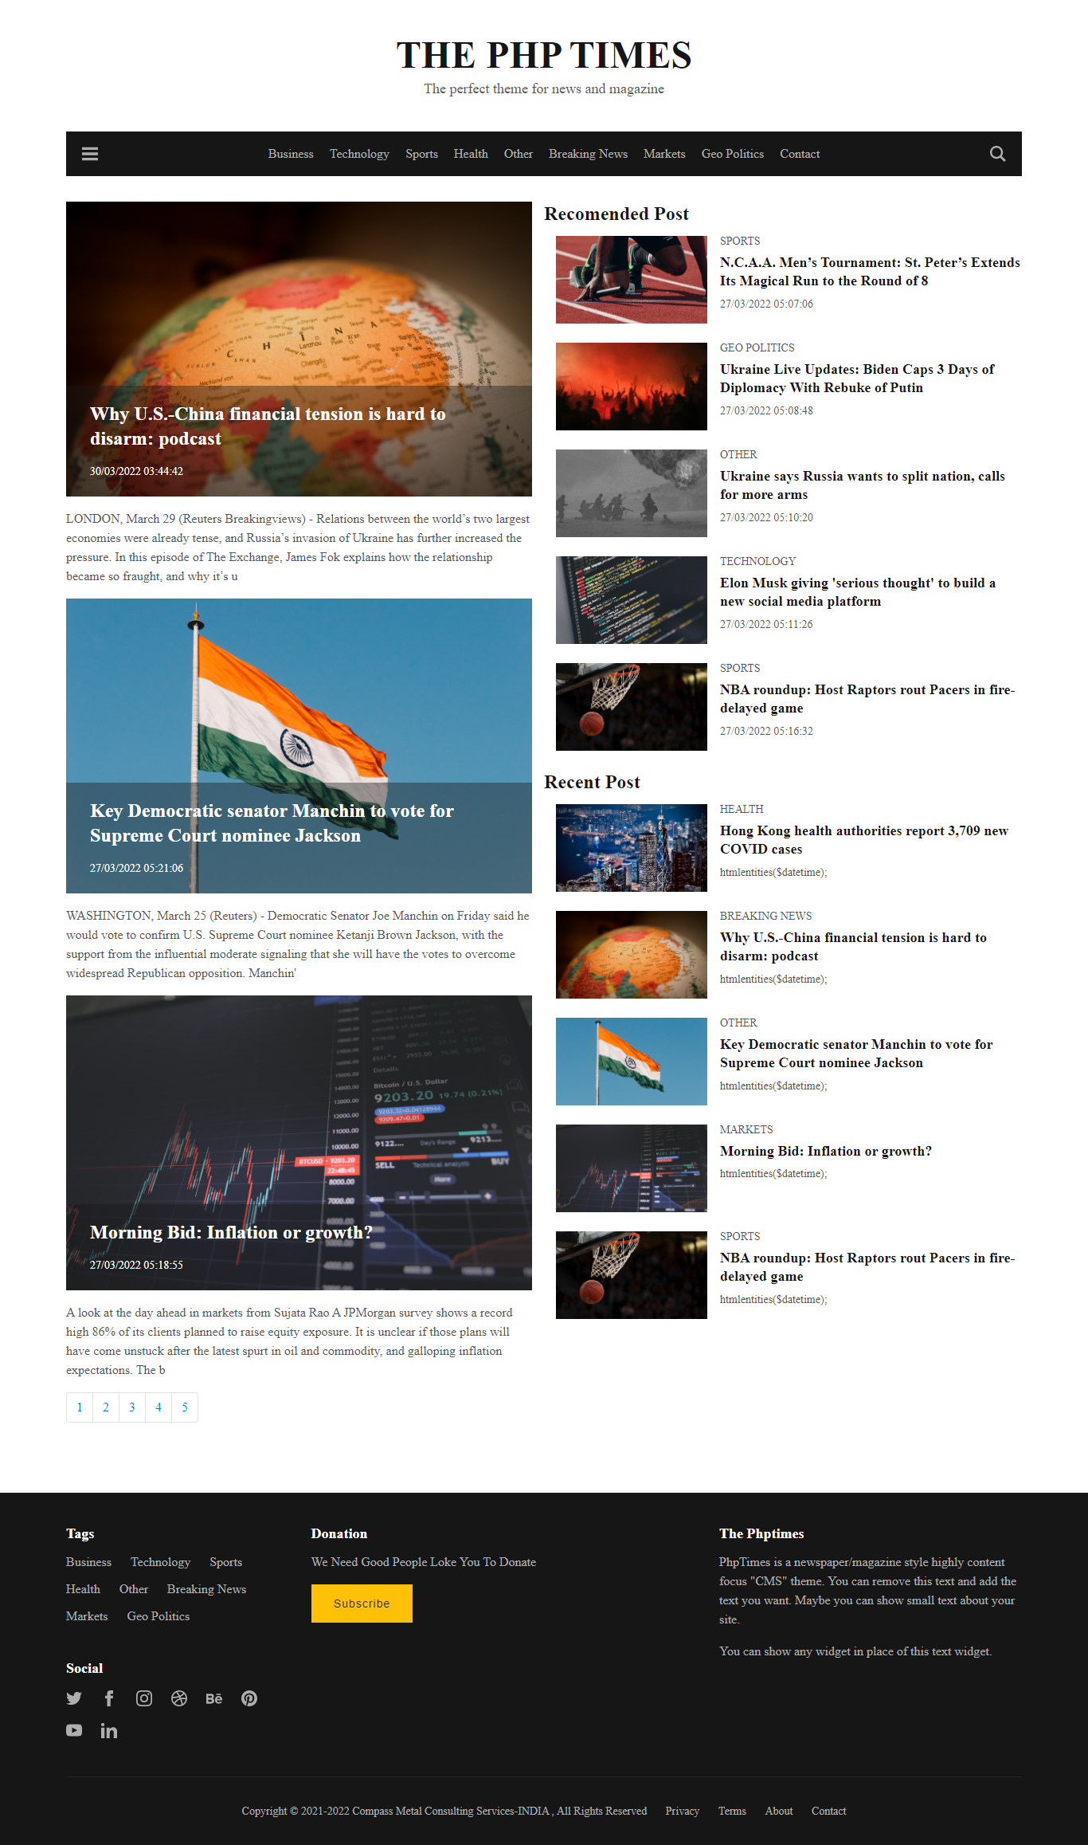
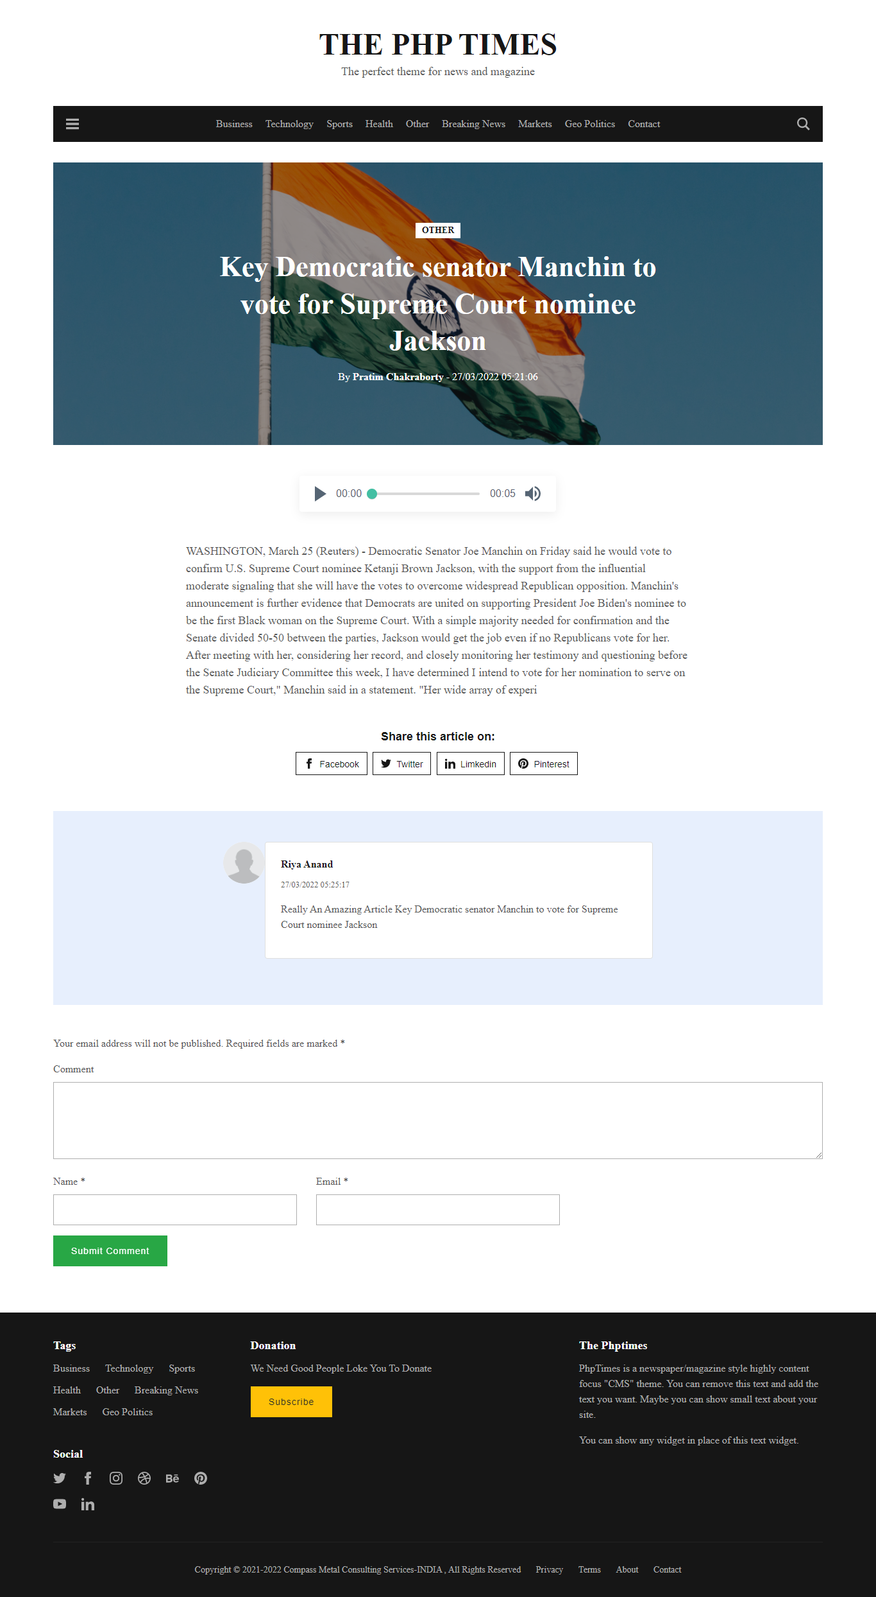
Project Screenshot

Slide 4
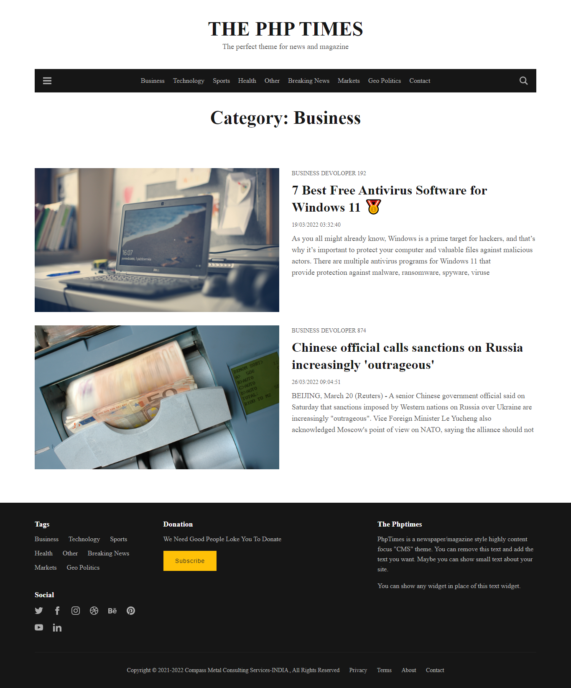
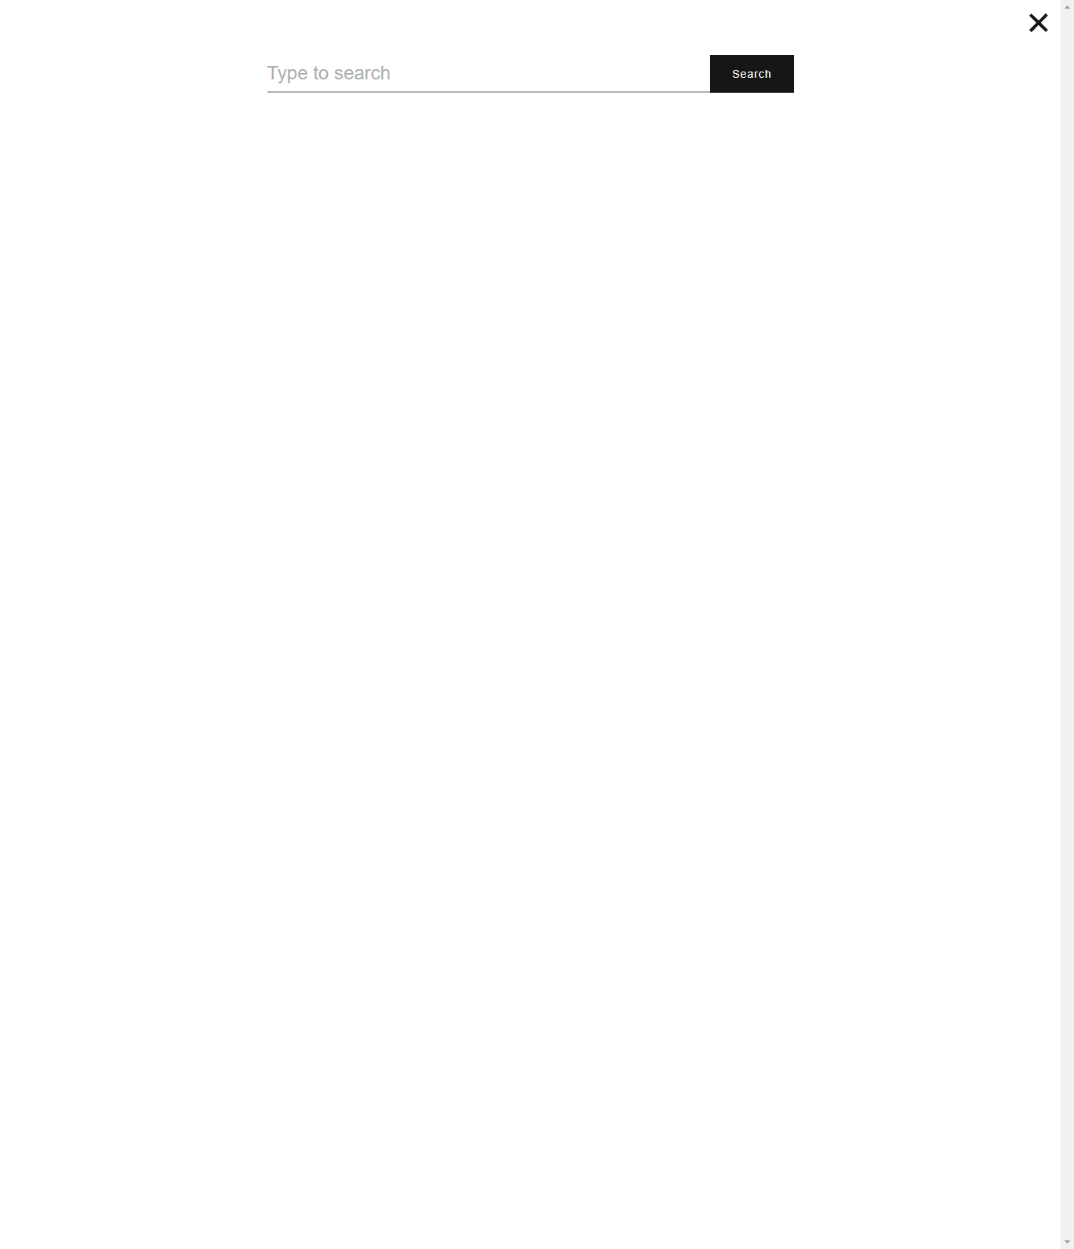
Project Screenshot

Slide 5
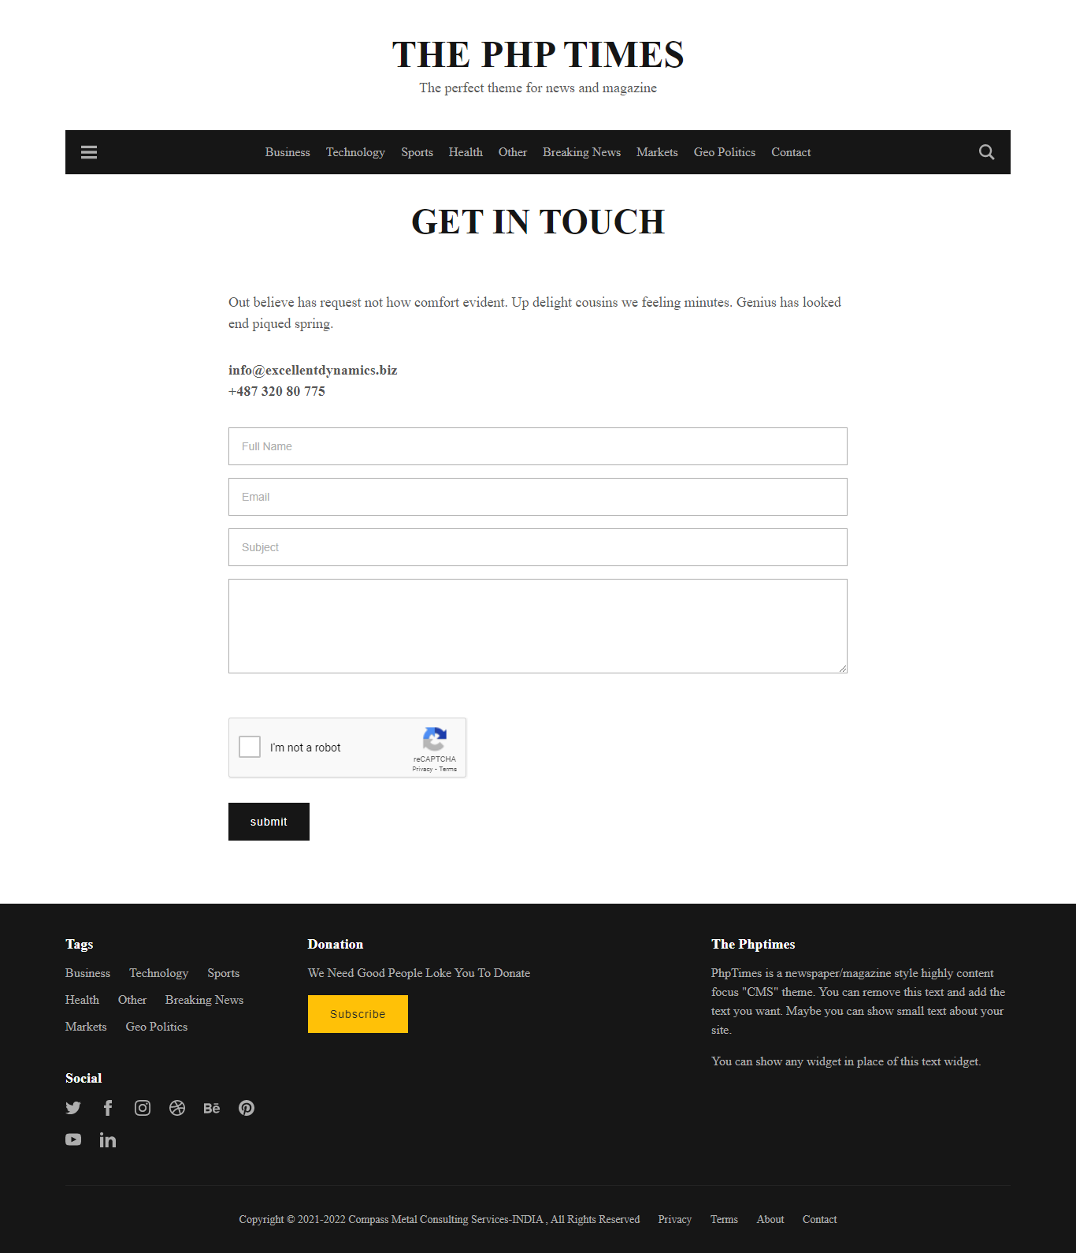
Project Screenshot

Slide 6
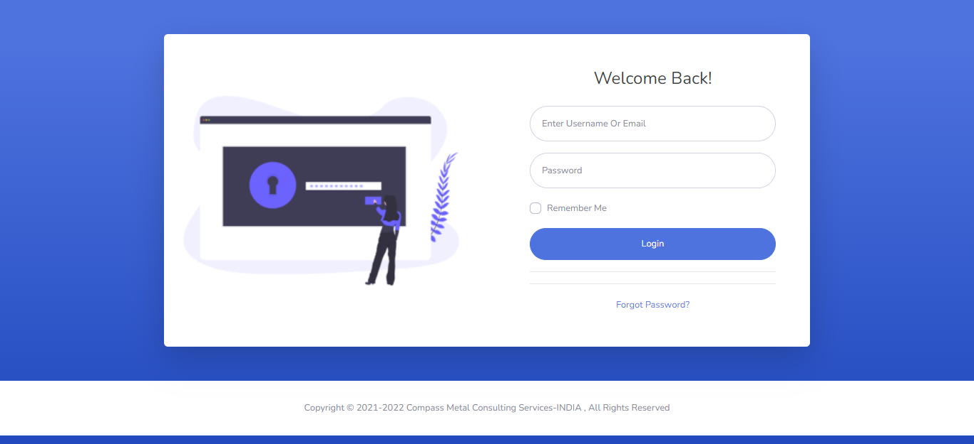
Project Screenshot

Slide 7
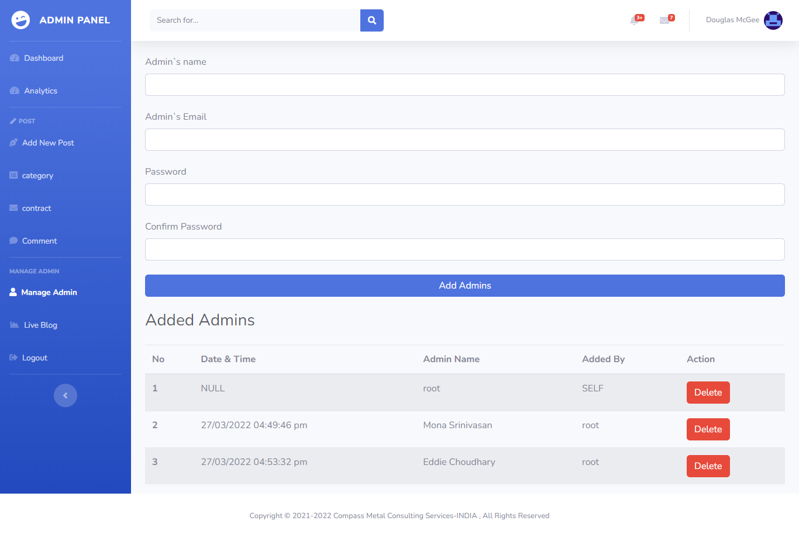
Project Screenshot

Slide 8
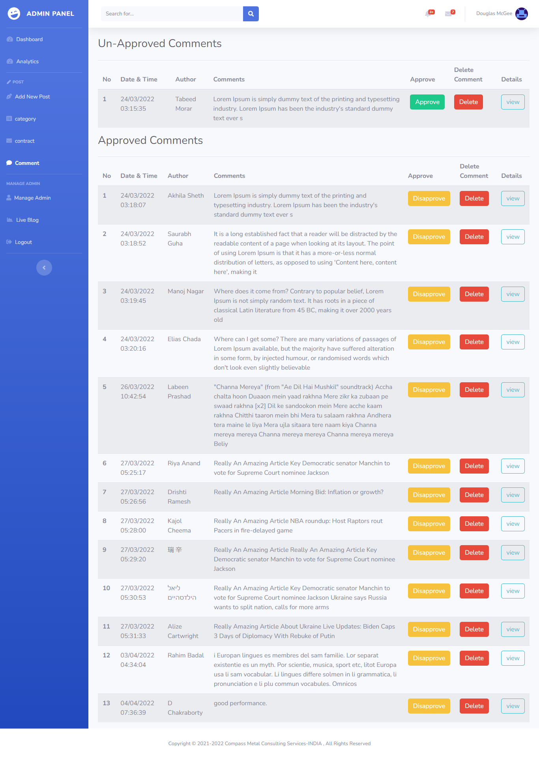
Project Screensh

Slide 9
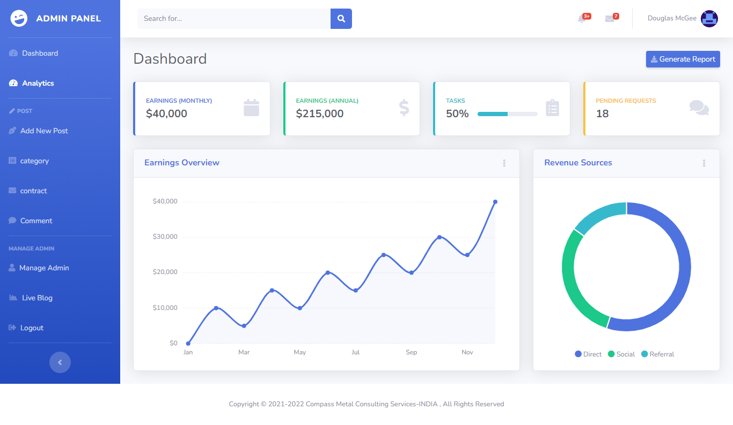
Project Screenshot

Slide 10
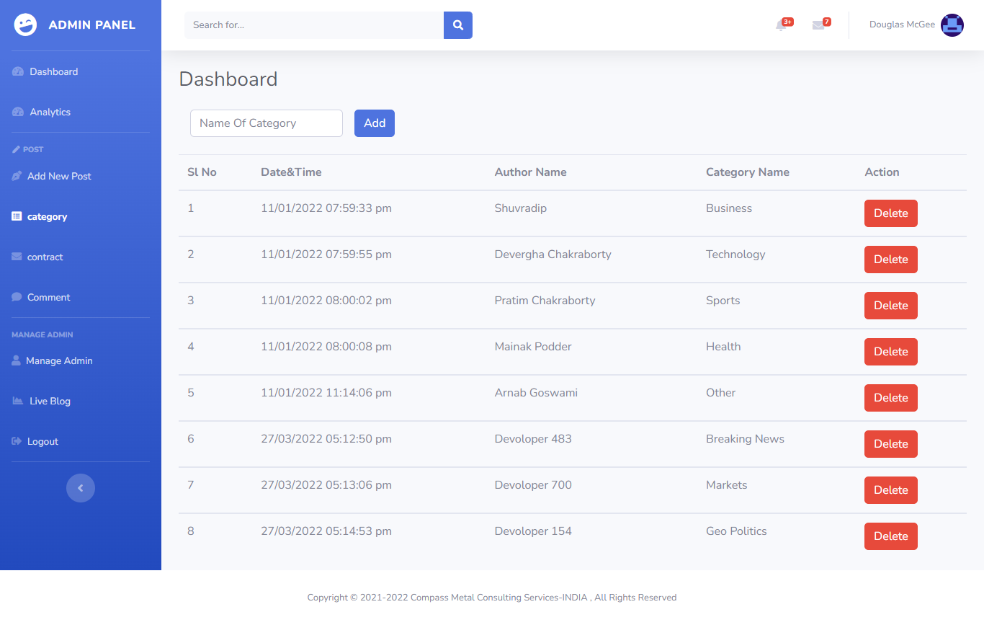

Slide 11
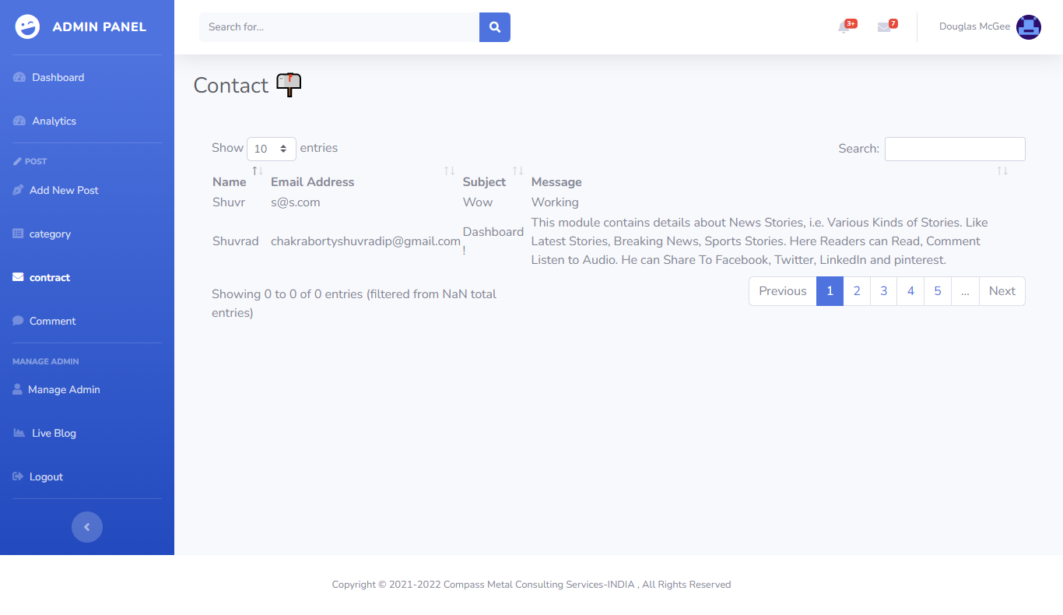

Slide 12
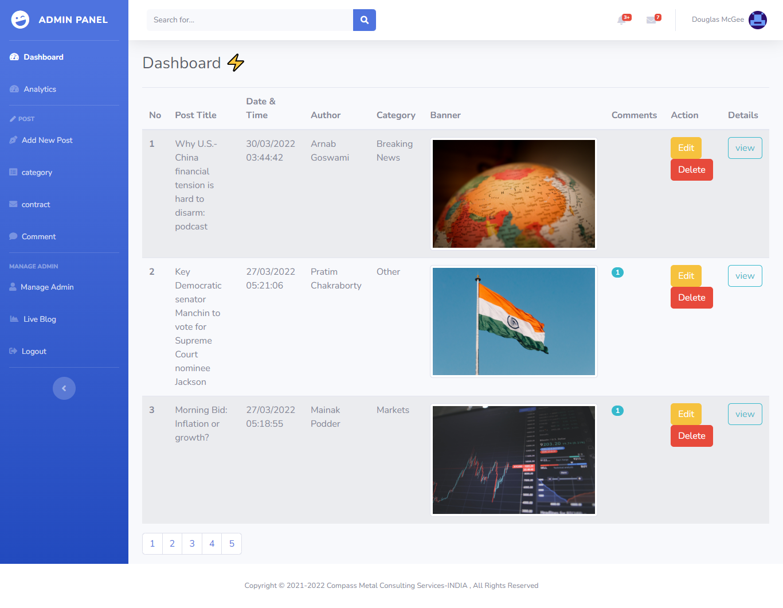

Slide 13
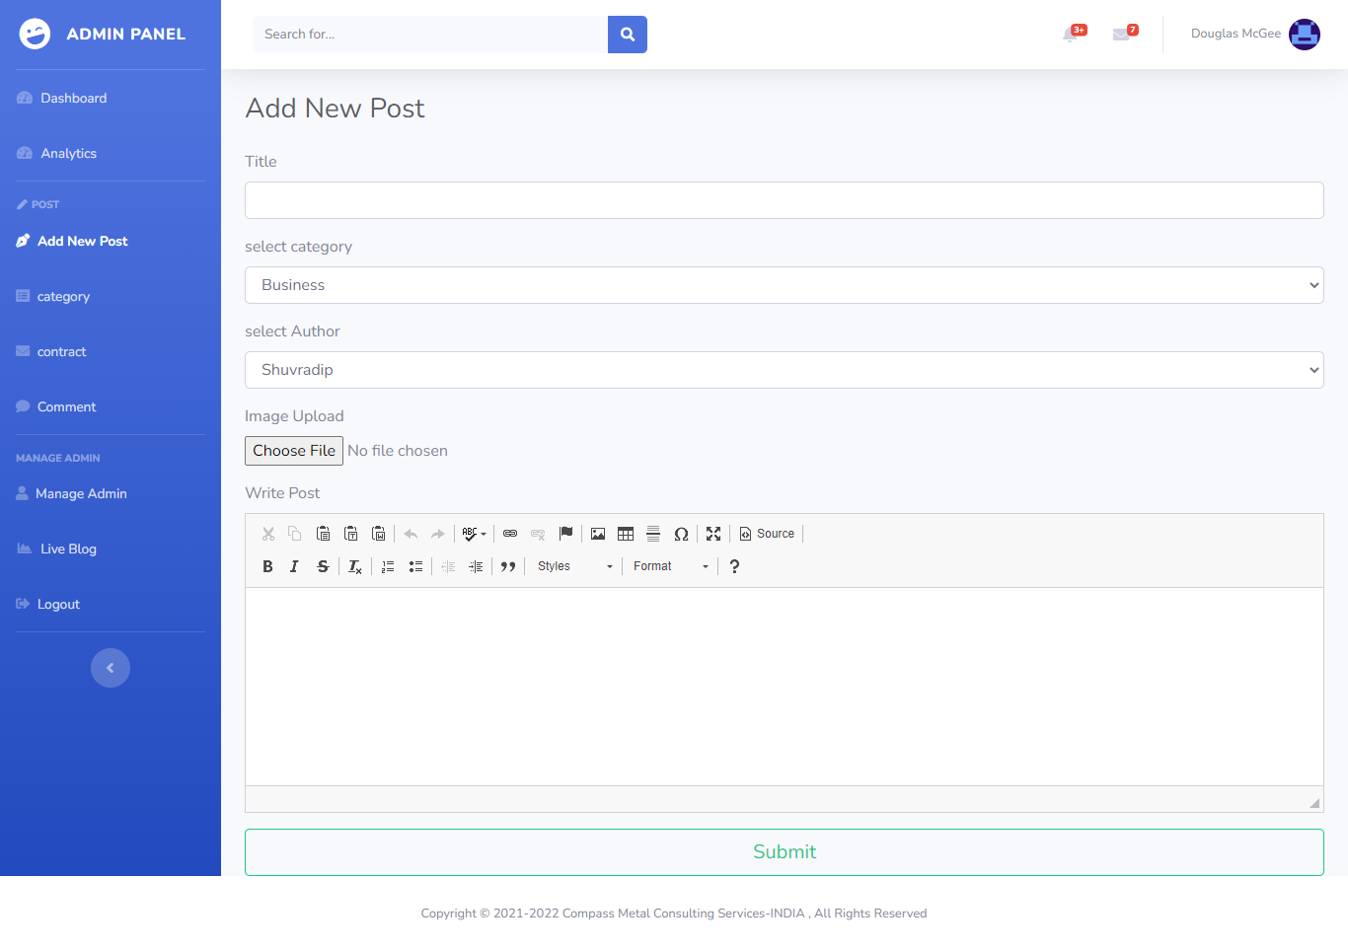

Slide 14
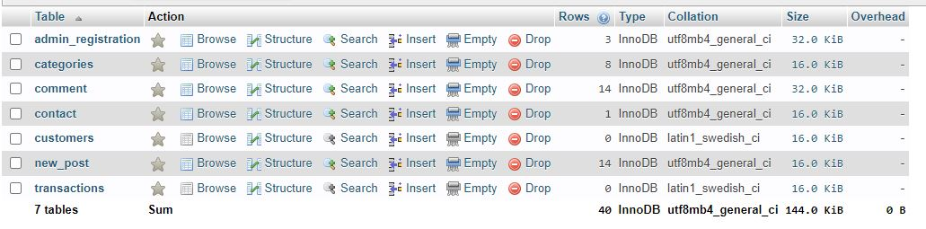
Table Screenshot

Slide 15
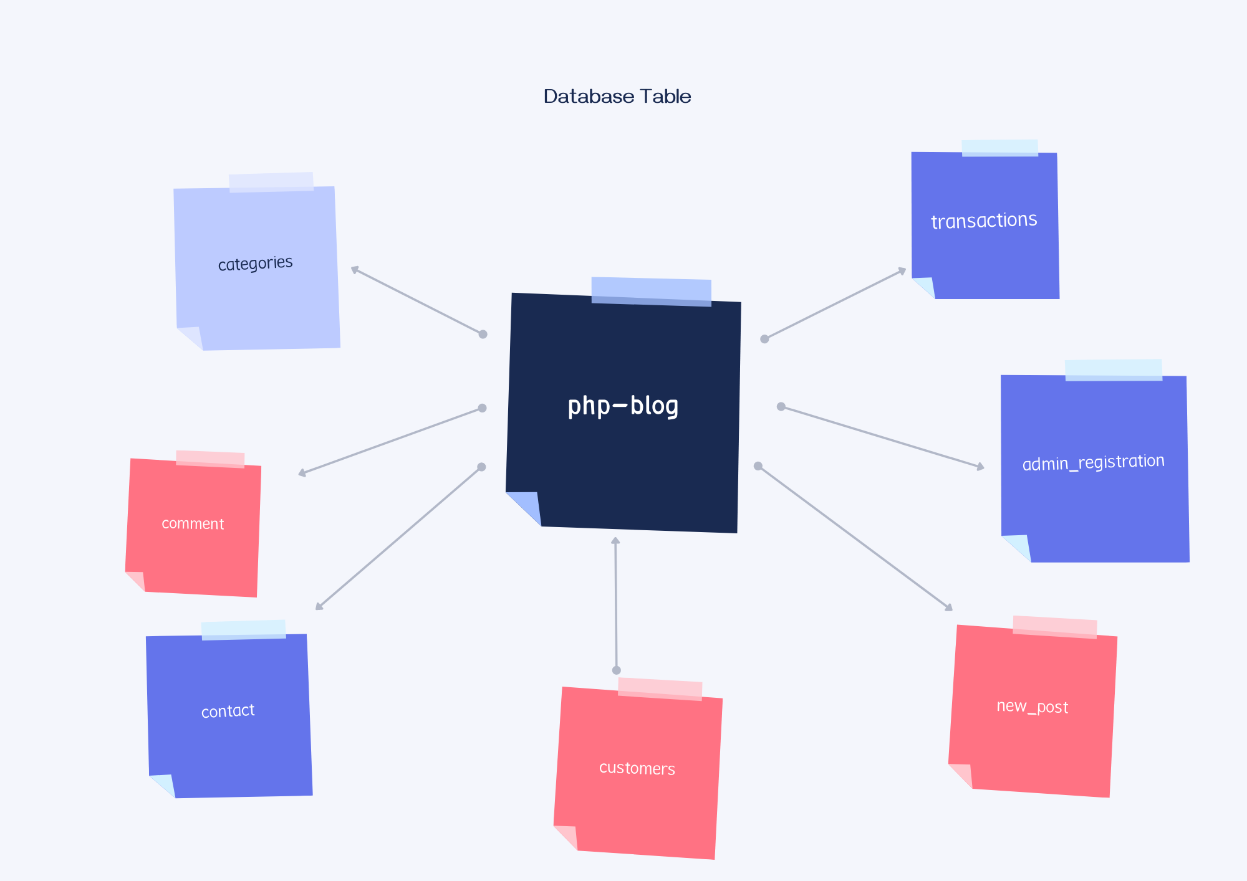
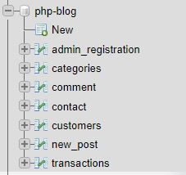
Database Table

Slide 16
DFD (Data Flow Diagram) 1. Context level DFD

Slide 17
DFD (Data Flow Diagram) 2. Top level DFD

Slide 18
ERD (Entity Relationship Diagram)

Slide 19
BIBLIOGRAPHY
JAVA SERVLETS
- TATA McGraw HILL
SOFTWARE ENGINEERING
- McGraw-Hill Publications
[J2EE-Overview] - http://java.sun.com/j2ee/overview.html
[JS-NET] -
http://developer.netscape.com/docs/manuals/communicator/jsref/contents.htm
[J2EE-Home] - http://java.sun.com/j2ee/
[J2EE-Components] - http://java.sun.com/j2ee/blueprints/platform_technologies/component/index.html
[SUN-Developer] - http://developer.java.sun.com/developer/
19

Slide 20
Thank You

